Slide 1


MAHENDRA ENGINEERING COLLEGE
(AUTONOMOUS)
MALLASAMUDHRAM
Password Manager
DATE:07/11/2024
TEAM MEMBERS :
VISHAL A(6113231281099)
SANJAY S(6113231281074)
SHEK MOHAMAD AKRAM B(6113231281082)

Slide 2
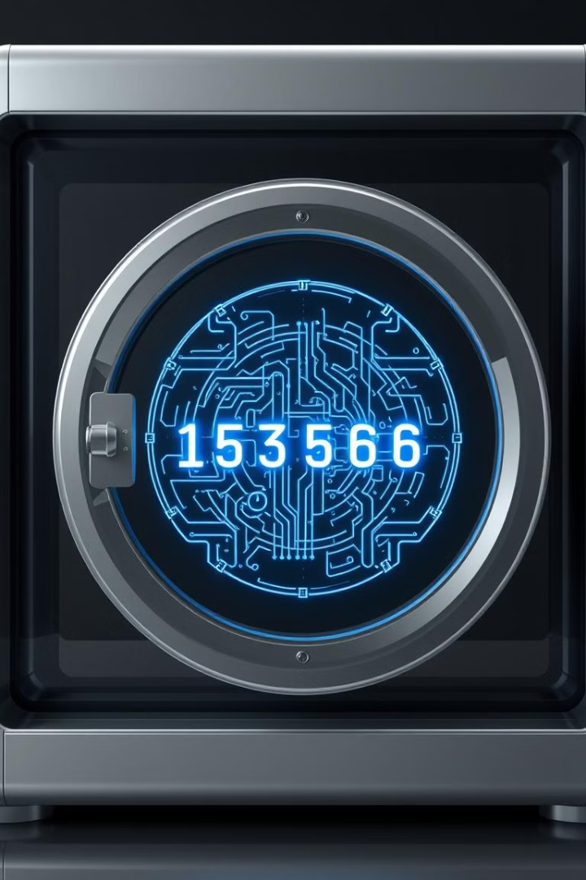
Password Manager Project
This Python-based password manager securely stores, retrieves, and generates passwords. It features encryption for data protection and a user-friendly GUI.
by Vishal A
VA

Slide 3
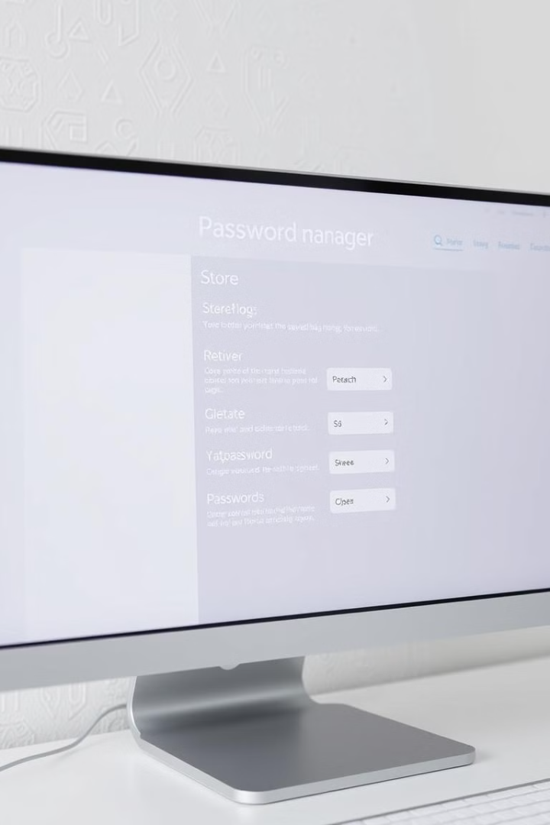
Project Overview
1
Store Passwords
2
Retrieve Passwords
Securely encrypt and save user passwords.
Easily access stored passwords when needed.
3
Generate Passwords
4
User Interface
Graphical interface using Tkinter for user-friendly interaction.
Create strong, randomized passwords for enhanced security.

Slide 4

Encryption Key Setup
1
Check for Key
The system checks if a key file exists.
2
Generate Key
If no key exists, a new one is generated.
3
Save Key
The new key is saved to a file for future use.
4
Load Key
If a key exists, it's loaded for encryption and decryption.

Slide 5
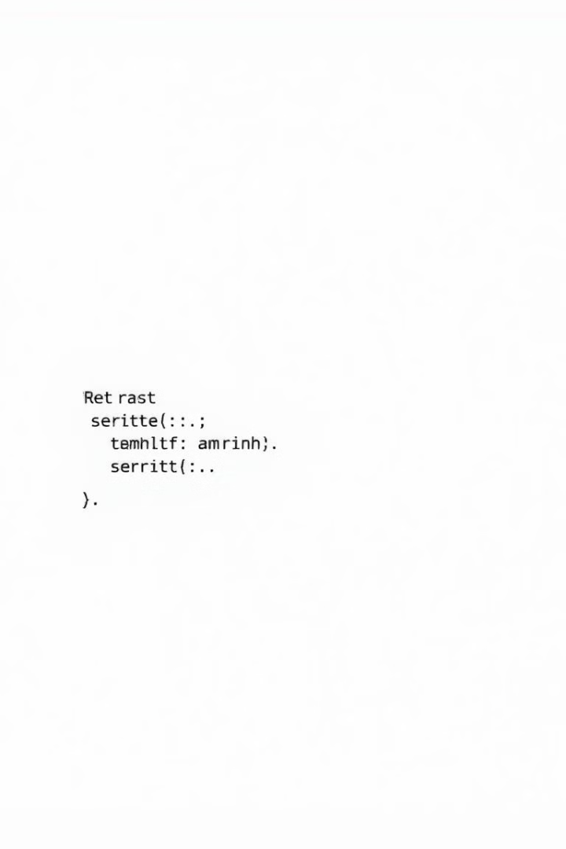
PasswordManager Class
Initialization
Load Data
Sets up data file and loads existing passwords.
Reads password data from JSON file or creates empty dictionary.
Save Data
Writes encrypted password data to JSON file.

Slide 6
Adding and Retrieving Passwords
Add Password
Retrieve Password
Encrypts password and saves with website and username.
Decrypts and returns password for given website.

Slide 7




Password Generation
Character Selection
Random Choice
Password Creation
Uses letters, digits, and punctuation for diversity.
Employs secrets module for secure character selection.
Combines chosen characters to form strong password.

Slide 8
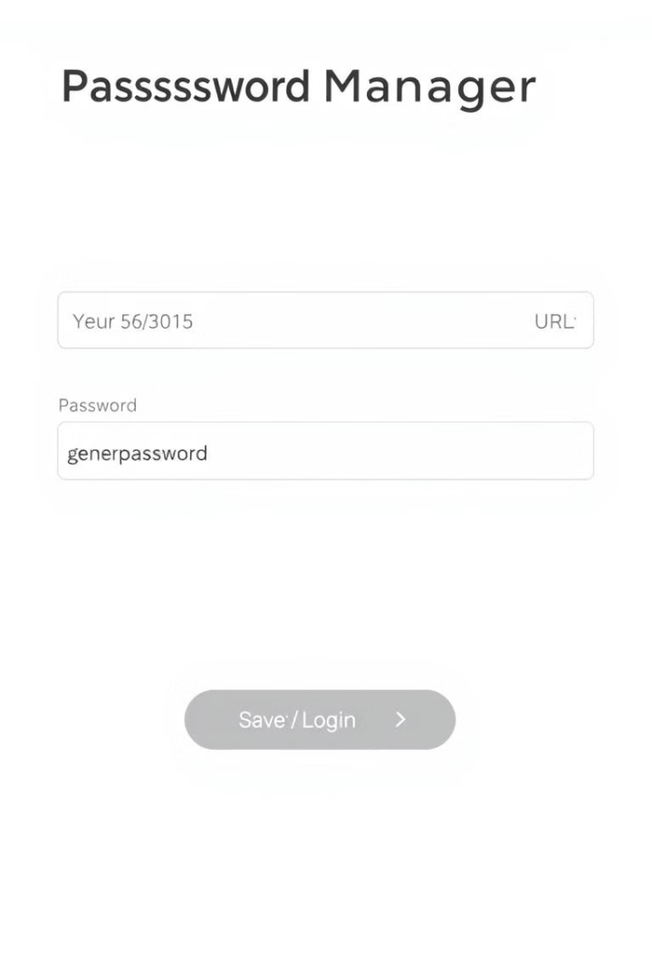



Graphical User Interface (GUI)
Main Window
Creates application window using Tkinter.
Input Fields
Adds text fields for website, username, and password.
Action Buttons
Implements buttons for adding, retrieving, and generating passwords.

Slide 9

Button Functions
Add Password
Encrypts and saves user input
Generate Password
Creates and fills random password
Retrieve Password
Decrypts and displays stored password

Slide 10
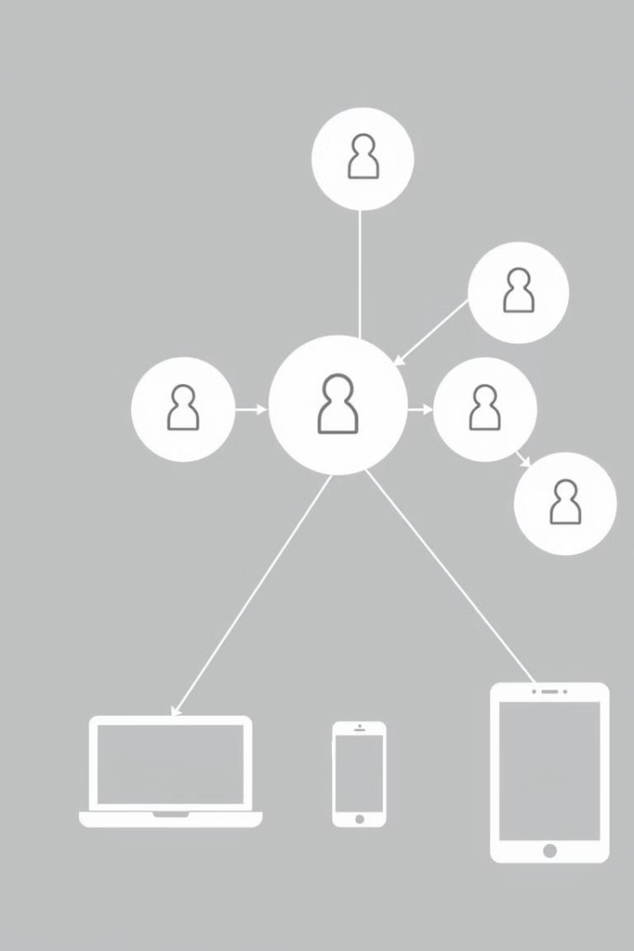
How It All Works Together
1
User Input
GUI allows easy interaction with the password manager.
2
Data Processing
Passwords are encrypted, stored, or retrieved as needed.
3
Security
Encryption protects stored passwords from unauthorized access.

Slide 11

Next Steps
1
Master Password
2
Clipboard Management
Add unlock feature for enhanced security.
Implement temporary password copying with auto-clear.
3
Backup Options
Create secure backup system for encrypted password file.

